Slide 1


Manatee County Grower Workshop
Results of Advanced Irrigation
Controller Testing on Vegetables
Lincoln Zotarelli, Ph.D.
Michael D. Dukes, Ph.D., P.E.
University of Florida
IFAS -Institute of Food and Agriculture Sciences
Agricultural & Biological Eng. Dept
Apopka, FL – May 2008

Slide 2
Introduction
Production challenges in Florida
High Temperature → Water demand → Supplemental Irrigation
SANDY SOILS
      Excessively well-drained
      Low soil organic matter
      Low water and nutrient holding capacity
      High application of water and nutrients

Slide 3
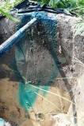
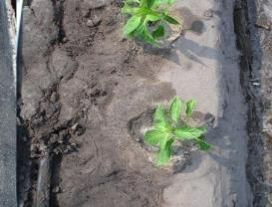
Introduction
High vertical water movement
Low lateral soil water movement
High susceptibility to NO₃-N leaching
Higher requirement
of fertilizer
direct effect on
production costs &
vegetable yield

Slide 4
Introduction
Conventional irrigation management: inadequate to ensure optimal resource use and to minimize nutrient leaching
Use of technological innovations can:
  enhance production efficiency
  provide local growers with a competitive edge
  reduce environmental impacts
Research priorities: Lack of precise information on crop water & nutrient status → excessive water & fertilizer use

Slide 5
Goal: Enhancing fertilizer use efficiency
Strategy: Improve water & N retention in the root zone
Implementation:
→ Proper rate & application of N-fertilizer
→ Use of soil moisture sensor based systems
→ Use of subsurface drip irrigation on tomatoes
→ Use of twin drip lines on peppers
Conceptualize research strategies

Slide 6
Actual soil moisture and irrigation on sandy soils
Saturation
Field Capacity
Wilting Point
VWC > 30%
-1 cbar
-0.001 MPa
VWC approx. 10-12%
-10 cbar
-0.01 MPa
VWC approx. 6%
-1500 cbar
-1.5 MPa
Soil Moisture Sensor can also translate soil moisture to voltage!
e.g. 525 mV 430 mV 320 mV

Slide 7
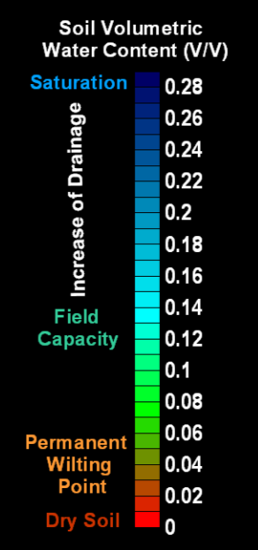
Soil moisture sensors and automated irrigation
SMS
miliVolts
540 mV
500 mV
430 mV
340 mV
300 mV
Ideal
soil moisture to:
1. Maximize yield
2. Minimize irrigation water application
3. Reduce N-leaching

Slide 8
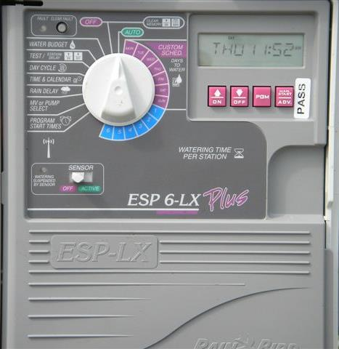
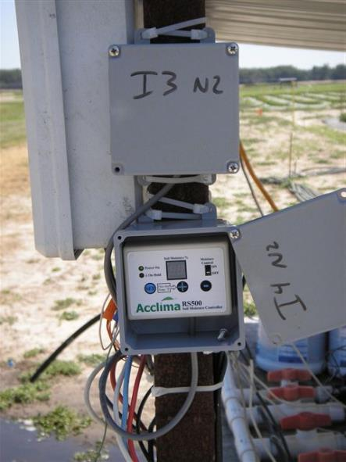
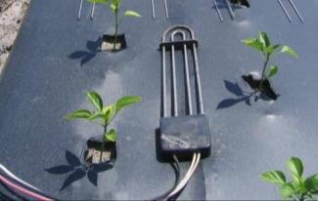
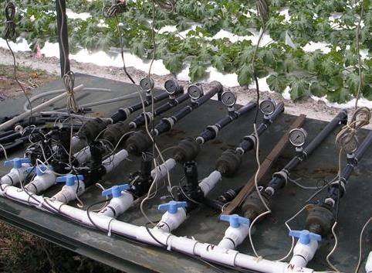
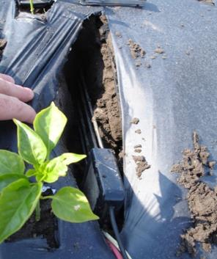
Soil moisture sensors and automated irrigation
Soil moisture probe
2. Controller
3. Timer
Solenoid valve
on/off

Slide 9
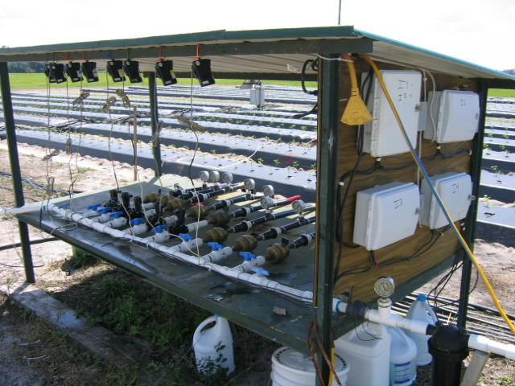
Soil moisture sensors and automated irrigation
Controller
Soil Moisture
Sensor
Timer
Solenoid valve
Flowmeters
Pressure regulator
Filter

Slide 10
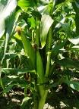
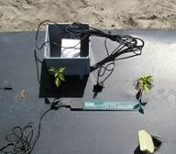
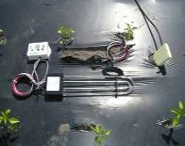
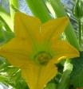
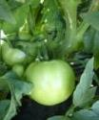
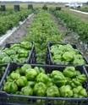
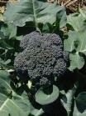
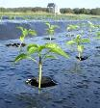
Sensor Based Irrigation Control

Slide 11
Local: Plant Science Research and Education Unit
Citra, Marion Co., FL
Sandy soil, organic matter below 1%
Crops:
Spring Tomato (3yr) – “Florida 47”
Spring (4yr) and Fall (2 yr) - Green Bell Pepper “Brigadier”
Fall Zucchini (2yr) – “Wild Cat”
Experimental Field

Slide 12
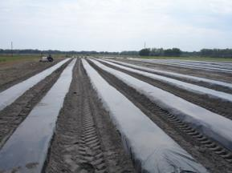
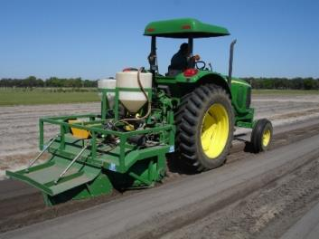
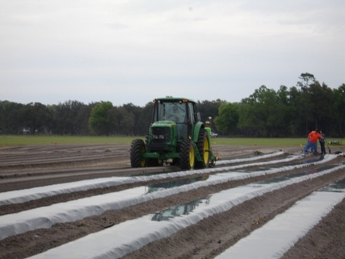
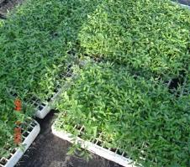
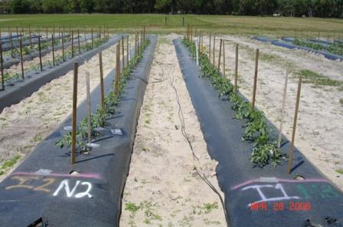
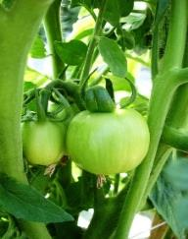
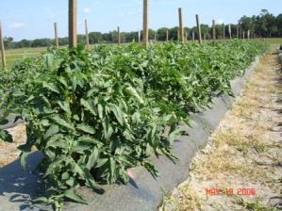
Field Preparation /
Mulching / Fumigation / Transplanting

Slide 13
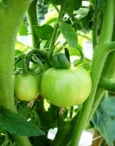
Experimental Field - Irrigation Treatments
Tomato
Soil moisture sensor threshold
10% VWC - SINGLE DRIP IRRIGATION
irrigation 5 possible windows of 24 min
depending of the VWC
10% VWC – SDI, subsurface drip irrigation
irrigation 5 possible windows of 24 min
depending of the VWC
3. TIME FIXED – 2h of continuous irrigation
(approx. 0.2 in/day)

Slide 14
Tomato Bed System – Subsurface Drip Irrigation
Fertigation Drip
Irrigation Drip
Soil Depth Layers
0-6 inches
6-12 inches
12 – 24 inches
24 – 36 inches
Fertigation Wet Zone “Bulb”
Irrigation Wet Zone “Bulb”

Slide 15

Tomato: Yield & Irr. Use Efficiency
 | Irrigation |  |  | Water | Marketable Yield |  |  | Irr Water Use
Treatment | inches |  | gal/100 ft | Saved | 1000 lb/acre | 25lb Box/acre |  | Efficiency lb/100 gal
Spring 2006
SM sensor |  | 7.3 | 2,965 | 47% | 133 a | 2144 a |  | 26 a
SDI |  | 10.8 | 3,984 | 29% | 127 a | 2052 a |  | 17 b
Fixed Time |  | 15.4 | 5,665 | 0% | 106 b | 1706 b |  | 10 c
Spring 2007
SM sensor |  | 8.9 | 3,289 | 40% | 189 a | 3058 a |  | 31 a
SDI |  | 13.9 | 5,143 | 7% | 174 a | 2815 a |  | 18 b
Fixed Time |  | 15.0 | 5,506 | 0% | 156 b | 2530 b |  | 15 c

Slide 16
Tomato: Yield & N-rate
a
a
N-fertilizer
Calcium nitrate
a
a
a
a

Slide 17
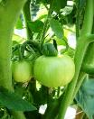
Tomato: water percolation and nitrate leaching
a
a
b
c
c
d
b
b

Slide 18
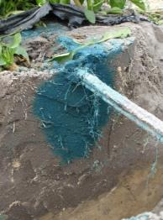
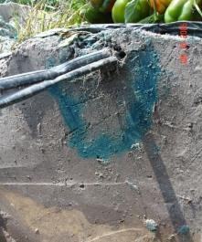
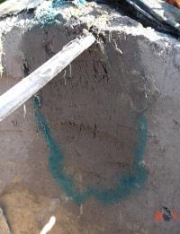
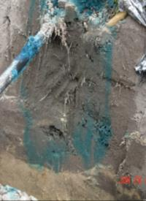

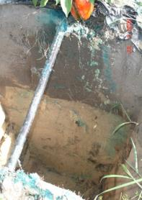
Effect of irrigation on solute displacement
(injecting dye in fertigation lines)
24 hrs
3 days
7 days
soil sensor based
irrigation
16in
fixed time irrigation schedule
+38 in

Slide 19
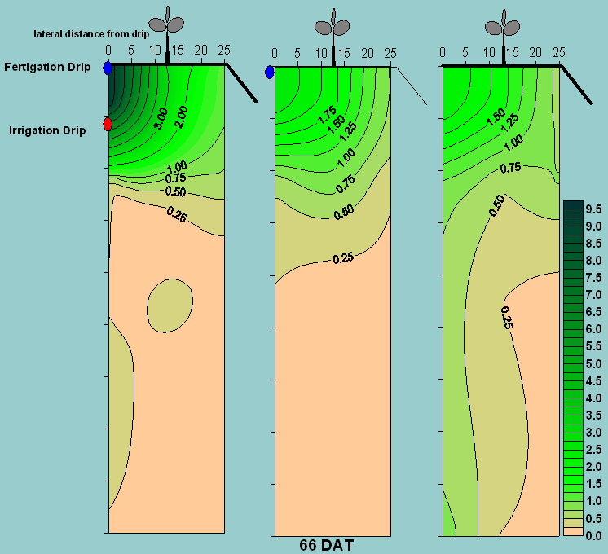
Tomato
Root length density (cm cm⁻³)
6 in
78%
66%
51%
12 in
13%
22%
28%
9%
12%
21%
Fixed
time
SDI
SMS
36 in

Slide 20
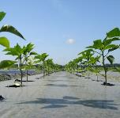
Experimental Field - Irrigation Treatments
Green Bell Pepper
Soil moisture sensor threshold
4% VWC - irrigation 5 possible windows of 24 min
depending of the VWC (only Spring 08)
2. 8% VWC - “
3. 10% VWC - “
4. 12% VWC - “
5. TIME FIXED – 2h of continuous irrigation (~ 0.2 in/day)

Slide 21
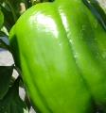
Pepper: Yield & Irr. Use Efficiency
 |  | Irrigation |  | Water |  | Marketable Yield |  |  | Irr Water Use
Treatment |  | inches | gal/100 ft | Savings |  | 1000 lb/acre | 30lb Box/acre |  | Efficiency lb/100 gal
Spring 2007
SMS 8% | 6.5 |  | 2,376 | 50% |  | 26.3 a | 877 a |  | 15 a
SMS 10% | 7.0 |  | 2,594 | 45% |  | 24.3 a | 811 a |  | 13 a
SMS 12% | 10.4 |  | 3,825 | 18% |  | 20.5 a | 684 a |  | 8 b
Fixed Time | 12.6 |  | 4,637 | 0% |  | 22.8 a | 761 a |  | 6 b

Slide 22
Pepper: Yield & N-rate
a
a
N-fertilizer
Calcium nitrate
a
a
a
a
N-rate (lb of N/ac) of calcium nitrate

Slide 23
Pepper: water percolation and nitrate leaching
a
a
ab
ab
b
b
c
c
c

Slide 24
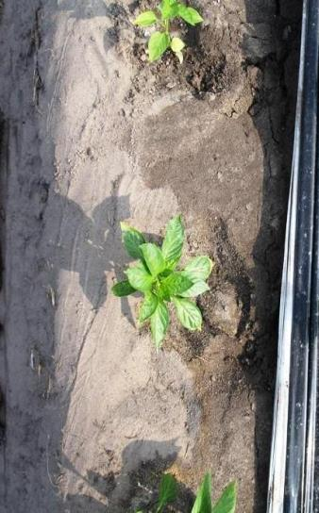
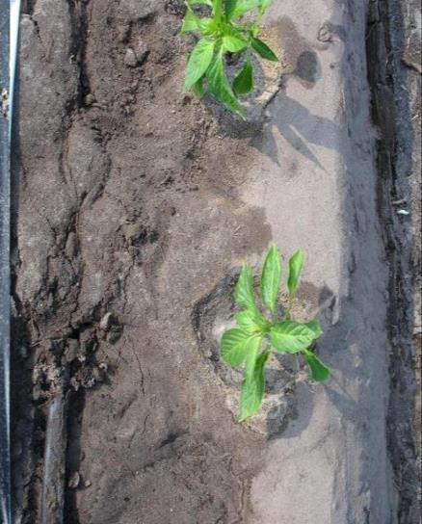
Application uniformity
dry soil
at side of the bed
wet soil
TWIN DRIP LINES
drip tape at
center of the bed
Photo: L. Zotarelli
Soil moisture after 1 hour of irrigation

Slide 25
Pepper: Yield & Irr. Use Efficiency
Spring 2008
 |  | Irrigation |  | Water | Marketable Yield |  |  | IWUE
Treatment |  | inches | gal/100 ft | Saving | 1000 lb/acre | 30lb Box/acre |  | lb/100 gal
Single Drip
SMS 4% |  | 3.2 | 1,174 | 76% | 23.5 c | 795 d |  | 27.2 a
SMS 8% |  | 4.6 | 1,710 | 65% | 27.4 b | 913 c |  | 21.7 b
SMS 12% |  | 5.4 | 2,000 | 60% | 31.9 b | 1,064 b |  | 21.5 b
Fixed Time 2h |  | 13.4 | 4,941 | 0% | 29.4 b | 981 b |  | 8.1 c
F. Time 4x24 min |  | 10.2 | 3.767 | 23% | 36.2 a | 1,207 a |  | 15.6 b
Twin Drip
SMS 8% |  | 4.4 | 1,623 | 67% | 27.0 b | 901 c |  | 22.5 b
SMS 12% |  | 7.9 | 2,912 | 41% | 37.4 a | 1,249 a |  | 17.4 b
Single N-rate of 200 lb/ac

Slide 26
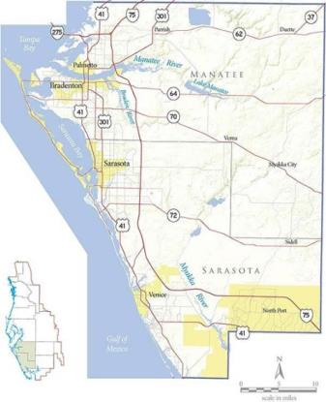
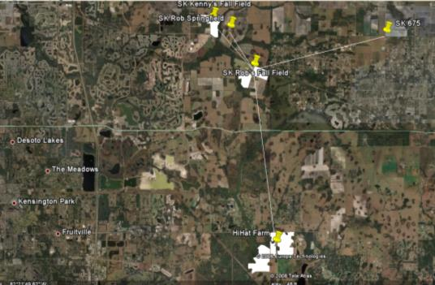
PROJECT: Evaluation and Demonstration of Soil Moisture Based On-demand Irrigation Controllers for Vegetable Production (SWFWMD B228)

Slide 27
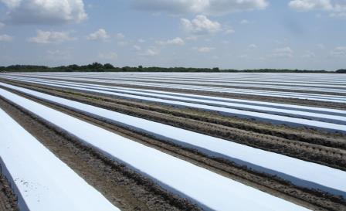
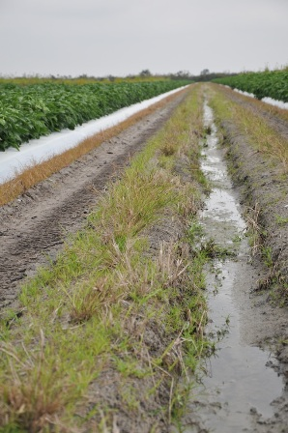
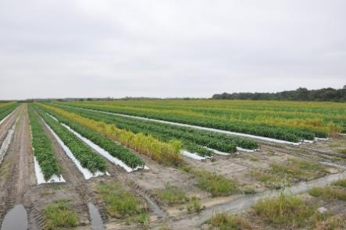
PROJECT: Evaluation and Demonstration of Soil Moisture Based On-demand Irrigation Controllers for Vegetable Production (SWFWMD B228)
Soil: Spodosol
Slope: <2%
Water table: 20-36 inches
Pepper variety: HM2641
Transplanting: Sep 15 2008

Slide 28
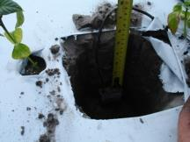
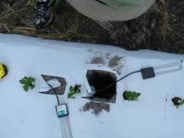
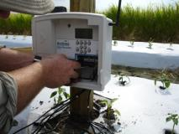
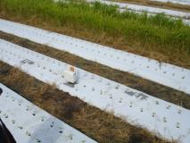
PROJECT: Evaluation and Demonstration of Soil Moisture Based On-demand Irrigation Controllers for Vegetable Production
Acclima Data
Recorder
Antenna
Sensor# 1
Sensor# 3
Raised bed
2-6 inches
8-14 inches
Sensor# 2
Sensor# 4

Slide 29
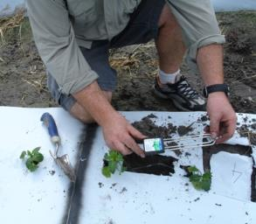
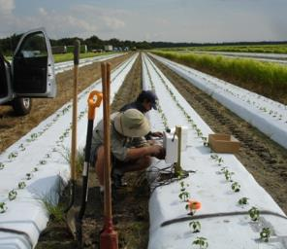
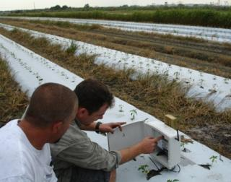
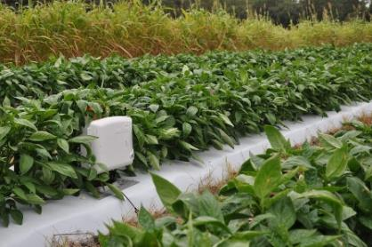
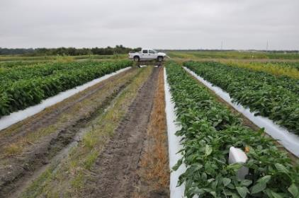
PROJECT: Evaluation and Demonstration of Soil Moisture Based On-demand Irrigation Controllers for Vegetable Production

Slide 30

PROJECT: Evaluation and Demonstration of Soil Moisture Based On-demand Irrigation Controllers for Vegetable Production (SWFWMD B228)
2,170 ft
Manifold
Zone 4 5 6
A
D
Drip Lines
980 ft
C
N
B
Aprox. 41 acres
Flush valves
Sensor Data recorder (Acclima SD12)
Manifold and drip
Photo source: Web Soil Survey, NRCS. http://websoilsurvey.nrcs.usda.gov/app/.

Slide 31
PROJECT: Evaluation and Demonstration of Soil Moisture Based On-demand Irrigation Controllers for Vegetable Production

Slide 32
Conclusions
Sensor-based irrigation systems increased water use efficiency and yield for tomato and pepper
Application of N rates in excess of 200 lb/ac (IFAS recommendation) did not increase yield with rigorous control of the irrigation
Combination of high irrigation rates with high N rates greatly increased nitrate leaching
Subsurface drip irrigation (tomato) can be an efficient option to reduce N leaching maintaining yields
Twin drip (pepper) offer a better water distribution in the bed which may result in higher yields

Slide 33
Future Research
Evaluation of research plot practices (e.g. SMS irrigation, small frequent irrigation events) at field scale
Development of scheduling recommendations
Detailed analysis of sensor positioning in plastic mulched beds and minimum number of sensors per area
Use of electrical conductivity to track fertilizer movement in the soil
Use of wireless communication between soil moisture sensors and irrigation controllers

Slide 34

Questions?
Thanks!
Acknowledgements:
Research supported by Southwest Florida Water Management District (B228) and Florida Dept. of Agric. and Consumer Serv. Project FDACS # 9189.
We’d like to thank the staff at the PSREU research facility in Citra, FL, Buck Nelson, Larry Miller, Danny Burch, Andy Schreffler, for their assistance with field operations.

